Slide 1
onCareer
January 18, 2018
Team onCareer
Project Owner: Steven Suh
Initial Scrum Master: Jeff Yang
Members: Drew Caltagirone, Kyle Batross, Swapnil Patil, Tony Dang
Notes:
Steven

Slide 2
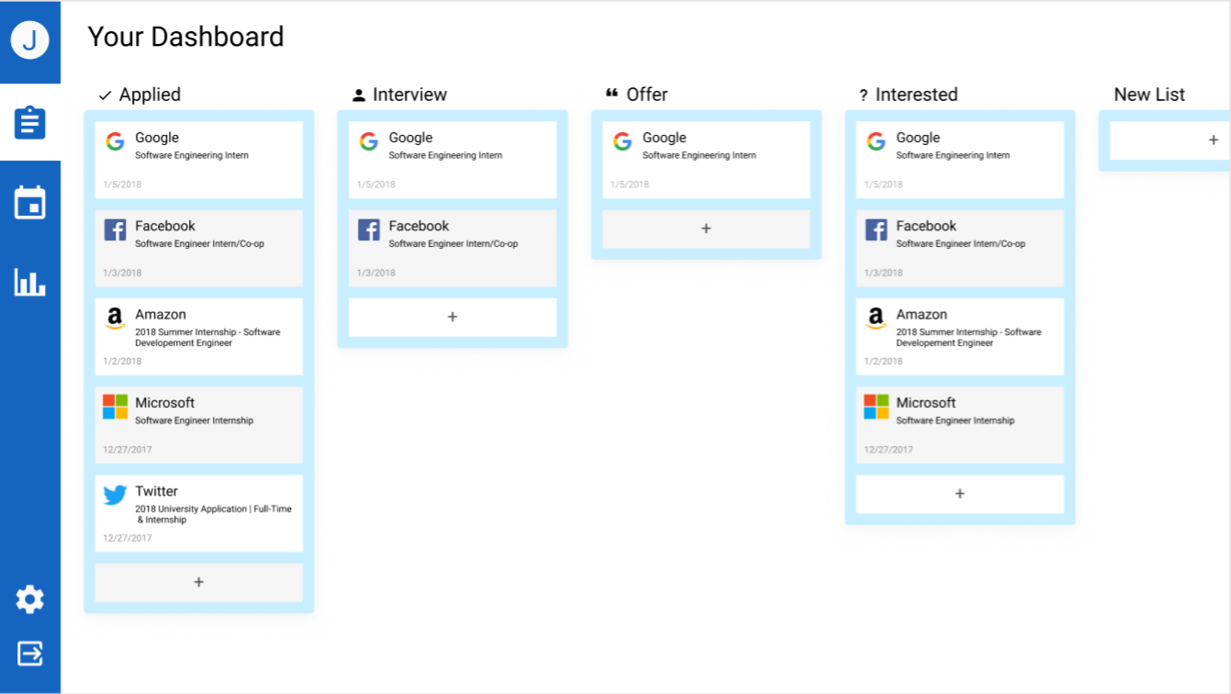
onCareer
As job search becomes more accessible to everyone, there needs to be an effective way to manage job applications.
Therefore, we intend to create a web application that helps users organize and keep track of job applications in an efficient manner.
Mockup
Notes:
Steven

Slide 3
Sprint 1
User Story 1 - Learning Technologies - As a developer, I want to learn new technologies to implement the web app so that I can develop the product.
User Story 2 - Landing Page - As a user, I want a landing page to summarize the website and login at so that I can have easy access.
User Story 3 - User Accounts - As a user, I want an account so that I can save and personalize my board.
Notes:
Jeff

Slide 4
Sprint 2
User Story 4 - Dashboard - As a user, I need a dashboard so that I can see all of my application categories.
User Story 5 - Navigation between pages - As a user I want to be able to navigate between pages for simplicity.
User Story 6 - Calendar - As a user I want to be able to represent my applications on a calendar timeline
Notes:
Swap, Testing

Slide 5
Sprint 3
User Story 7 - Analytics - As a user, I want provided analytics so that I can learn more about the companies I am applying to.
User Story 8 - Improve UI/Navigation - As a developer, I want to improve the UI and navigation so that the user will have a better navigation experience.
User Story 9 - Testing and Finalization - As a developer, I want to finish and test the finalized product so that I can ensure the product is ready to ship.
Notes:
tony

Slide 6
Architecture
https://drive.google.com/file/d/1pFiBeZSNbMhPCwef9R88q2JurUQJCwfH/view?usp=sharing
https://www.figma.com/file/fzAR0uvRmJXK7BZ9L2YOoEsE/CS115-Job-App-Organizer
Notes:
Steven

Slide 7
Challenges and Risks
Version control and dividing equal work between teammates
Work completed efficiently and on time
Learning new technologies
Creating a web app that is user-friendly
Notes:
Kyle

Slide 8



Technologies
Programming Languages: JavaScript, HTML, CSS
Web Technologies: Node.js, React, MongoDB, Google Calendar API
Tools and Environments: Git, GitHub, Slack, Google Drive
Notes:
drew

